Slide 1
Everyday performance fuckups
Łukasz Pyrzyk

Slide 2
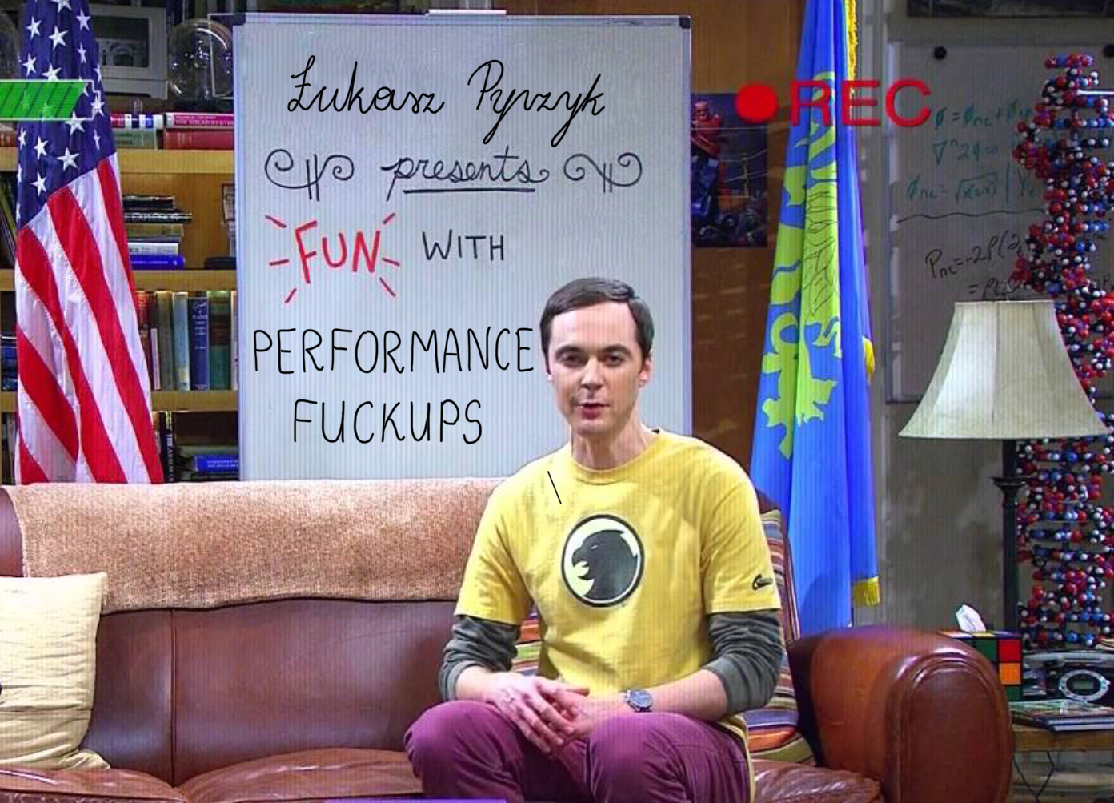
Everyday performance fuckups
Łukasz Pyrzyk

Slide 3

Łukasz pyrzyk
Co-founder of Dotnetos
Microsoft MVP
Senior Full Stack Cloud Developer at Sonova​
Tweets as @lukaszpyrzyk

Slide 4
Fuckup #0
preparing 97 slides for 45 minutes talk
@lukaszpyrzyk

Slide 5
Fuckup #1 Assuming performance improvement
@lukaszpyrzyk

Slide 6
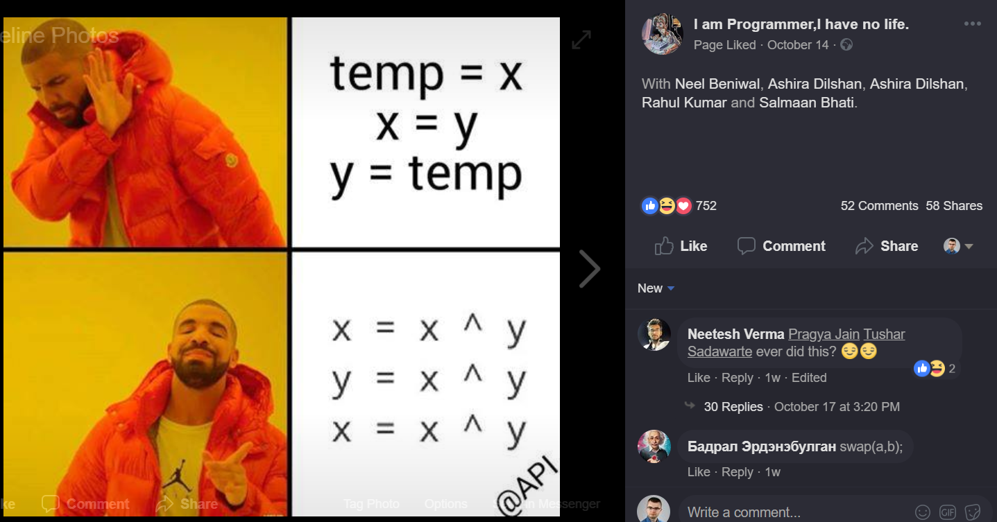

Slide 7

public void XOR(ref int x, ref int y)
{
x = x ^ y;
y = x ^ y;
x = x ^ y;
}
No temp int variable
int is 4 bytes, so it saves 4 bytes
Assembly has XOR operation, so it’s 1:1, so it’s fast
@lukaszpyrzyk

Slide 8
Method | Mean | Error | StdDev | Median
XOR | 2.8275 ns | 0.0615 ns | 0.0575 ns | 2.8419 ns
@lukaszpyrzyk

Slide 9
Method | Mean | Error | StdDev | Median
XOR | 2.8275 ns | 0.0615 ns | 0.0575 ns | 2.8419 ns
TempVariable | 0.0114 ns | 0.0131 ns | 0.0123 ns | 0.0069 ns
@lukaszpyrzyk

Slide 10
Getting assembly from c#
sharplab.io by Andrey Shchekin
The Ultimate .NET Experiment (TUNE) by Konrad Kokosa
DisassemblyDiagnoser in BenchmarkDotNet
IDE
@lukaszpyrzyk

Slide 11
XOR
00007ff9`b7092140 418b00 mov eax,dword ptr [r8]
00007ff9`b7092143 3102 xor dword ptr [rdx],eax
00007ff9`b7092145 8b02 mov eax,dword ptr [rdx]
00007ff9`b7092147 413100 xor dword ptr [r8],eax
00007ff9`b709214a 418b00 mov eax,dword ptr [r8]
00007ff9`b709214d 3102 xor dword ptr [rdx],eax
00007ff9`b709214f c3 ret
TempVariable
00007ff9`b70b2140 8b02 mov eax,dword ptr [rdx]
00007ff9`b70b2142 418b08 mov ecx,dword ptr [r8]
00007ff9`b70b2145 890a mov dword ptr [rdx],ecx
00007ff9`b70b2147 418900 mov dword ptr [r8],eax
00007ff9`b70b214a c3 ret
@lukaszpyrzyk

Slide 12
public void AddAndSubtract(ref int x, ref int y)
{
x = x + y;
y = x - y;
x = x - y;
}
@lukaszpyrzyk

Slide 13
Method | Mean | Error | StdDev | Median
XOR | 2.8275 ns | 0.0615 ns | 0.0575 ns | 2.8419 ns
TempVariable | 0.0114 ns | 0.0131 ns | 0.0123 ns | 0.0069 ns
AddAndSubtract | 2.8454 ns | 0.0691 ns | 0.0646 ns | 2.8798 ns
@lukaszpyrzyk

Slide 14
TIP Always measure your changes
@lukaszpyrzyk

Slide 15
TIP “Swap two variables without using temp variable” popular interview question
@lukaszpyrzyk

Slide 16
Fuckup #2 Trying to be smarter than compiler
@lukaszpyrzyk

Slide 17

@lukaszpyrzyk

Slide 18
public void M()
{
int x = 4096, y = 8192;
x = x ^ y;
y = x ^ y;
x = x ^ y;
Console.WriteLine(x);
Console.WriteLine(y);
}
@lukaszpyrzyk

Slide 19
public void M()
{
int x = 4096, y = 8192;
int temp = x;
x = y;
y = temp;
Console.WriteLine(x);
Console.WriteLine(y);
}
@lukaszpyrzyk

Slide 20
Benchmarking….
@lukaszpyrzyk

Slide 21
It is the same! He is a liar!
@lukaszpyrzyk

Slide 22
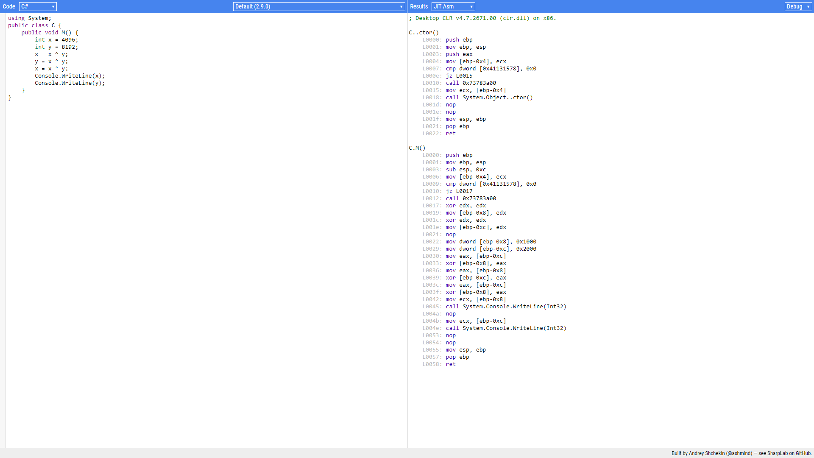
Debug assembly 30 lines

Slide 23
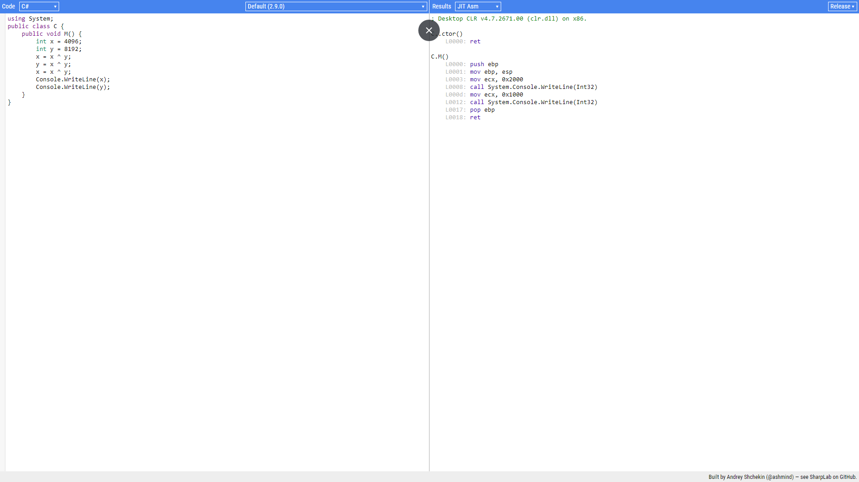
Release assembly 8 lines

Slide 24
Fuckup #2 Trying to be smarter than compiler. TIP: You might be. But usually, you won’t.
@lukaszpyrzyk

Slide 25
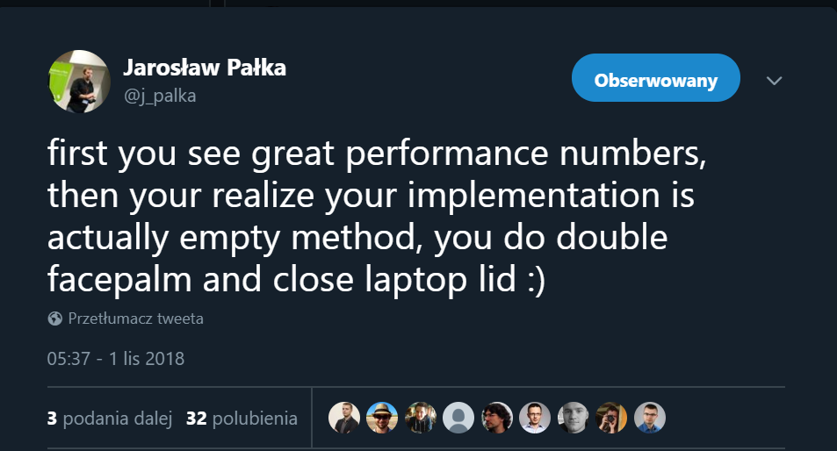
@lukaszpyrzyk

Slide 26

@lukaszpyrzyk

Slide 27
public class TelemetryEntry
{
public DateTimeOffset Timestamp { get; set; }
public int UserId { get; set; }
}
@lukaszpyrzyk

Slide 28
[Route("[controller]")]
[ApiController]
public class TelemetryController : Controller
{
[HttpPut]
public async Task<IActionResult> Insert([FromServices] DataStorageService db)
{
var entry = CreateEntry();
await db.Insert(entry);
return NoContent();
}
}
@lukaszpyrzyk

Slide 29
public class DataStorageService
{
private readonly DataStorageServiceOptions _options; private readonly DocumentClient _client;
public SlowDataStorageService(DataStorageServiceOptions options)
{
_options = options;
_client = new DocumentClient(options.Endpoint, options.ApiKey);
_client.CreateDatabaseIfNotExistsAsync(new Database { Id = options.DatabaseName }).GetAwaiter().GetResult();
_client.CreateDocumentCollectionIfNotExistsAsync(
UriFactory.CreateDatabaseUri(options.DatabaseName),
new DocumentCollection { Id = options.CollectionName })
.GetAwaiter().GetResult();
}
}
GetAwaiter().GetResult();
GetAwaiter().GetResult()
@lukaszpyrzyk

Slide 30
public async Task Insert(TelemetryEntry telemetryEntry)
{
var collectionUri = UriFactory.CreateDocumentCollectionUri(_options.DatabaseName, _options.CollectionName);
await _client.CreateDocumentAsync(collectionUri, telemetryEntry);
}
CreateDocumentCollectionUri
@lukaszpyrzyk

Slide 31
public void ConfigureServices(IServiceCollection services)
{
var dbOptions = GetOptions();
services.AddSingleton(dbOptions);
services.AddTransient<DataStorageService>();
}
AddTransient
@lukaszpyrzyk

Slide 32
testing
How many entries can be saved?
“wrk -t1 -c1 -d30s http://localhost:5000/telemetry/insert/”
@lukaszpyrzyk

Slide 33
Testing – no docs
Running 30s test @ http://localhost:5000/telemetry/insert/slow
1 threads and 1 connections
Thread Stats Avg Stdev Max +/- Stdev
Latency 876.89ms 45.82ms 993.87ms 76.47%
Req/Sec 0.88 0.33 1.00 88.24%
34 requests in 30.07s, 2.69KB read
Requests/sec: 1.13
Transfer/sec: 91.57B
@lukaszpyrzyk

Slide 34
IT SUCKS
@lukaszpyrzyk

Slide 35
public class AsyncLazy<T> : Lazy<Task<T>>
{
public AsyncLazy(Func<Task<T>> valueFactory) : base(valueFactory)
{
}
}
@lukaszpyrzyk

Slide 36
public class DataStorageService
{
private readonly AsyncLazy<DocumentClient> _clientFactory; private readonly Uri _collectionUri;
public DataStorageService(DataStorageServiceOptions options)
{
_collectionUri = UriFactory.CreateDocumentCollectionUri(options.DatabaseName, options.CollectionName);
_clientFactory = new AsyncLazy<DocumentClient>(async () =>
{
var client = new DocumentClient(options.Endpoint, options.ApiKey);
await InitialDatabase(client, options);
});
}
}
@lukaszpyrzyk

Slide 37
public async Task Insert(TelemetryEntry telemetryEntry)
{
var client = await _clientFactory.Value;
await client.CreateDocumentAsync(_collectionUri, telemetryEntry);
}
@lukaszpyrzyk

Slide 38
public void ConfigureServices(IServiceCollection services)
{
var dbOptions = GetOptions();
services.AddSingleton(dbOptions);
services.AddSingleton<DataStorageService>();
}
@lukaszpyrzyk

Slide 39
Testing - optimizations
@lukaszpyrzyk

Slide 40
_clientFactory = new AsyncLazy<DocumentClient>(async () =>
{
var client = new DocumentClient(options.Endpoint, options.ApiKey, new ConnectionPolicy
{
ConnectionMode = ConnectionMode.Direct,
ConnectionProtocol = Protocol.Tcp
});
await InitialDatabase(client, options);
});
@lukaszpyrzyk

Slide 41
Testing – direct / tcp
@lukaszpyrzyk

Slide 42

The gone fuckup story
Microservices
CosmosDB
Migration to the Direct/TCP connection, feature toggle
Thousands of the GoneException saying “The requested resource is no longer available at the server”
We have a bug!!!
Race condition? Dispose? Network down? Firewall?
@lukaszpyrzyk

Slide 43

@lukaszpyrzyk

Slide 44
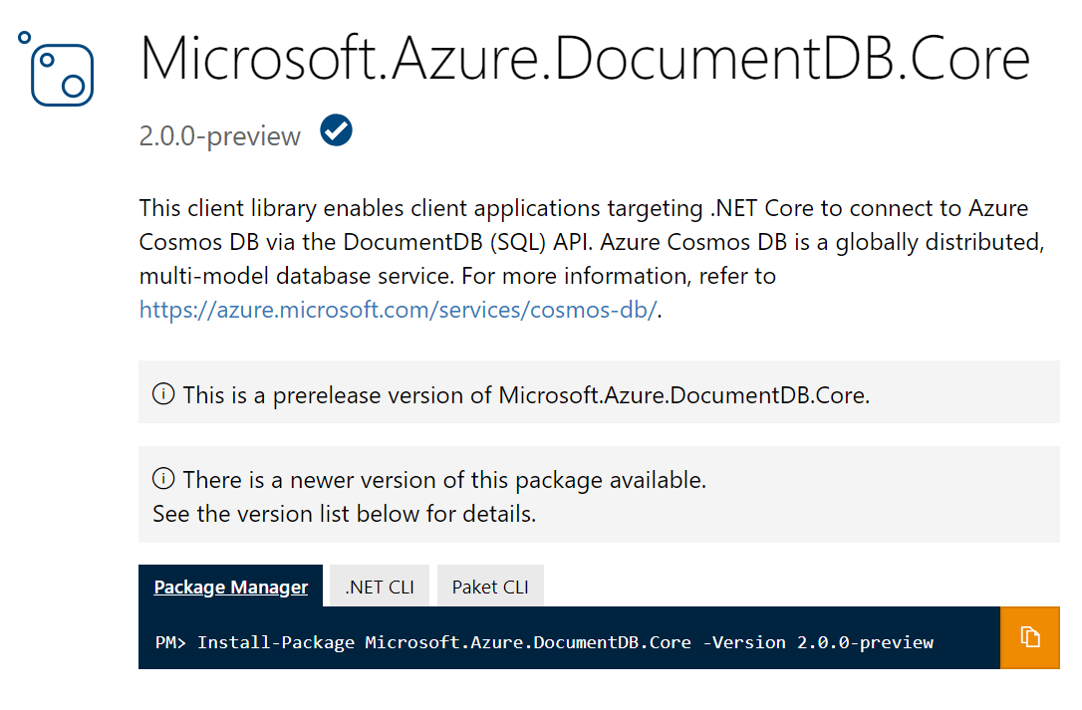
@lukaszpyrzyk

Slide 45
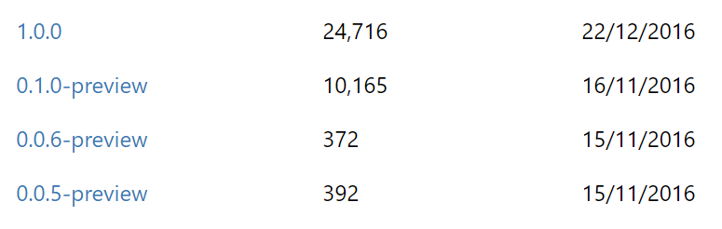
@lukaszpyrzyk

Slide 46
The gone fuckup story
GoneException(“The requested resource is no longer available at the server”)
might be
PlatformNotSupportedException();
@lukaszpyrzyk

Slide 47
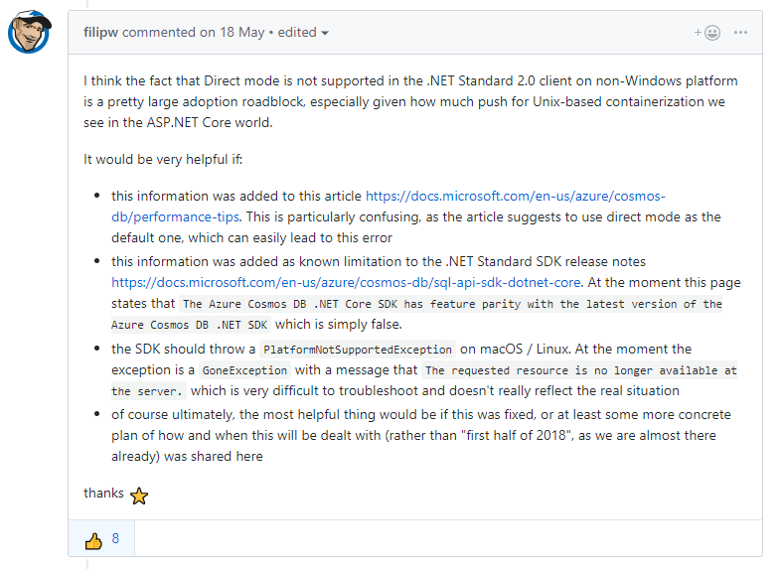
https://github.com/Azure/azure-cosmosdb-dotnet/issues/194
@lukaszpyrzyk

Slide 48
Fuckup #3 Buffering responses
@lukaszpyrzyk

Slide 49
Buffering a file
Github
blob
User
https://github.com/dotnet/corefx/archive/v2.2.0-preview3.zip
@lukaszpyrzyk

Slide 50
Buffering a file
Github
blob
Server
User
http://localhost:5000/download/
@lukaszpyrzyk

Slide 51
Buffering a file
public async Task<IActionResult> WithBuffering()
{
var request = new HttpRequestMessage(HttpMethod.Get, "dotnet/corefx/archive/v2.2.0-preview3.zip");
var response = await _client.Client.SendAsync(request);
var stream = await response.Content.ReadAsStreamAsync();
var contentType = response.Content.Headers.ContentType.MediaType;
return new FileStreamResult(stream, contentType);
}
@lukaszpyrzyk

Slide 52
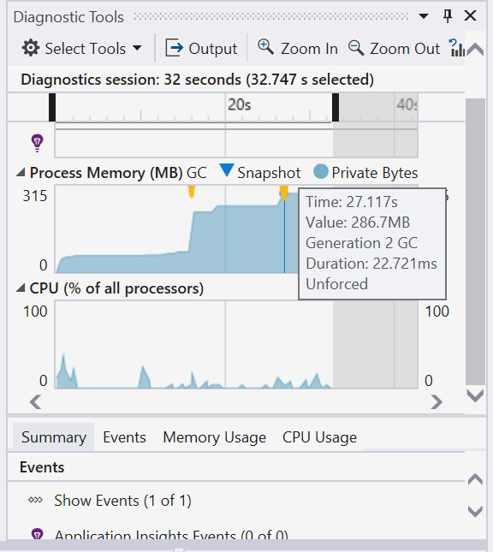
@lukaszpyrzyk

Slide 53
Buffering a file
public async Task<IActionResult> WithoutBuffering()
{
var request = new HttpRequestMessage(HttpMethod.Get, "dotnet/corefx/archive/v2.2.0-preview3.zip");
var response = await _client.Client.SendAsync(request, HttpCompletionOption.ResponseHeadersRead);
var stream = await response.Content.ReadAsStreamAsync();
var contentType = response.Content.Headers.ContentType.MediaType;
return new FileStreamResult(stream, contentType);
}
@lukaszpyrzyk

Slide 54
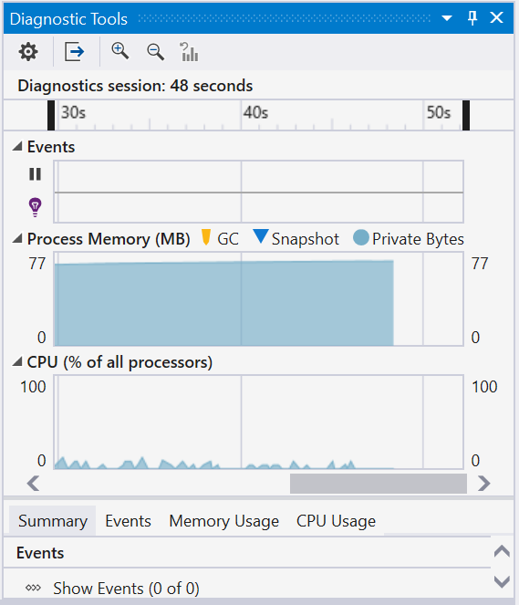
@lukaszpyrzyk

Slide 55
Buffering a file
public async Task<Stream> Stream()
{
var request = new HttpRequestMessage(HttpMethod.Get, "dotnet/corefx/archive/v2.2.0-preview3.zip");
var response = await _client.Client.GetStreamAsync(request.RequestUri);
return response;
}
@lukaszpyrzyk

Slide 56
TIP Don’t buffer big responses. Stream them
@lukaszpyrzyk

Slide 57
Fuckup #5 Let’s optimize it
@lukaszpyrzyk

Slide 58
The business problem
JIRA #2312 PoC of the new business feature
@lukaszpyrzyk

Slide 59

The business problem
This is very important for our company
It’s PoC
Please make it ASAP
Performance doesn’t matter
Don’t spend to much time on it
Keep clean and easy to understand for another developers
@lukaszpyrzyk

Slide 60
The business problem
KEEP
IT
SIMPLE
STUPID
@lukaszpyrzyk

Slide 61
public ulong SecretAlgorithm(ulong n)
{
if (n == 1 || n == 2) return 1;
return SecretAlgorithm(n - 2) + SecretAlgorithm(n - 1);
}
@lukaszpyrzyk

Slide 62
public ulong Fibonacci(ulong n)
{
if (n == 1 || n == 2) return 1;
return Fibonacci(n - 2) + Fibonacci(n - 1);
}
@lukaszpyrzyk

Slide 63

The business problem
It works
It is simple
@lukaszpyrzyk

Slide 64
The business problem
Make it faster!
@lukaszpyrzyk

Slide 65
The business problem
What kind of optimizations techniques do I know?
@lukaszpyrzyk

Slide 66
The business problem
THREADS FOR THE RESQUE
@lukaszpyrzyk

Slide 67
public ulong Fibonacci(ulong n)
{
if (n == 1 || n == 2) return 1;
var a = Task.Run(() => Fibonacci(n - 2));
var b = Task.Run(() => Fibonacci(n - 1));
Task.WaitAll(a, b);
return a.Result + b.Result;
}
@lukaszpyrzyk

Slide 68
@lukaszpyrzyk

Slide 69
LESS
THREADS
@lukaszpyrzyk

Slide 70
public ulong Fibonacci(ulong n)
{
if (n == 1 || n == 2) return 1;
var a = Task.Run(() => FibonacciImplementation(n - 2));
var b = Task.Run(() => FibonacciImplementation(n - 1));
Task.WaitAll(a, b);
return a.Result + b.Result;
}
private ulong FibonacciImplementation(ulong n)
{
if (n == 1 || n == 2) return 1;
return Recursive(n - 2) + Recursive(n - 1);
}
@lukaszpyrzyk

Slide 71
@lukaszpyrzyk

Slide 72
@lukaszpyrzyk

Slide 73
LET’S THINK
@lukaszpyrzyk

Slide 74
public static ulong Recursive(ulong n)
{
Console.WriteLine($"Calculating Fibonacci for {n}");
if (n == 1 || n == 2) return 1;
return Recursive(n - 2) + Recursive(n - 1);
}
@lukaszpyrzyk

Slide 75
Fibonacci(5);
Calculating Fibonacci for 5
Calculating Fibonacci for 3
Calculating Fibonacci for 1
Calculating Fibonacci for 2
Calculating Fibonacci for 4
Calculating Fibonacci for 2
Calculating Fibonacci for 3
Calculating Fibonacci for 1
Calculating Fibonacci for 2
@lukaszpyrzyk

Slide 76
WE DO THE SAME JOB
SEVERAL TIMES

Slide 77
Memoization
It is an optimization technique used primarily to speed up computer programs by storing the results of expensive function calls and returning the cached result when the same inputs occur again
@lukaszpyrzyk

Slide 78
Memoization
public ulong Fibonacci(ulong n)
{
if (n == 1 || n == 2) return 1;
var results = new ulong[n];
results[0] = 1;
results[1] = 1;
return FibWithMemoization(n, results);
}
@lukaszpyrzyk

Slide 79
Memoization
private static ulong FibWithMemoization(ulong n, ulong[] results)
{
var current = n - 1;
var previous = current - 1;
var beforePrevious = previous - 1;
if (results[beforePrevious] == 0)
results[beforePrevious] = FibWithMemoization (previous, results);
if (results[previous] == 0)
results[previous] = FibWithMemoization (current, results);
results[current] = results[beforePrevious] + results[previous];
return results[n - 1];
}
@lukaszpyrzyk

Slide 80
@lukaszpyrzyk

Slide 81
@lukaszpyrzyk

Slide 82
@lukaszpyrzyk

Slide 83

@lukaszpyrzyk

Slide 84
The business problem
Calculate Fibonacci sequence
Write recursion
Optimize it with parallel execution
Optimize it with data structures
@lukaszpyrzyk

Slide 85
The business problem
WHAT WE MISSED?
@lukaszpyrzyk

Slide 86
The business problem
Calculate Fibonacci sequence
Write recursion
Optimize it with parallel execution
Optimize it with data structures
@lukaszpyrzyk

Slide 87
public ulong Fibonacci(ulong n)
{
if (n == 1 || n == 2) return 1;
ulong a = 1, b = 1;
for (ulong i = 2; i < n; i++)
{
ulong temp = a + b;
a = b;
b = temp;
}
return b;
}
@lukaszpyrzyk

Slide 88
@lukaszpyrzyk

Slide 89
@lukaszpyrzyk

Slide 90
TIP before doing optimizations Make sure that current solution still fits
@lukaszpyrzyk

Slide 91
Summary
There are no projects without performance fuckups
They can be huge or small, but they are.
@lukaszpyrzyk

Slide 92
Summary
YOU MIGHT HAVE NO TIME TO FIX IT.
IT’S OKAY.
@lukaszpyrzyk

Slide 93
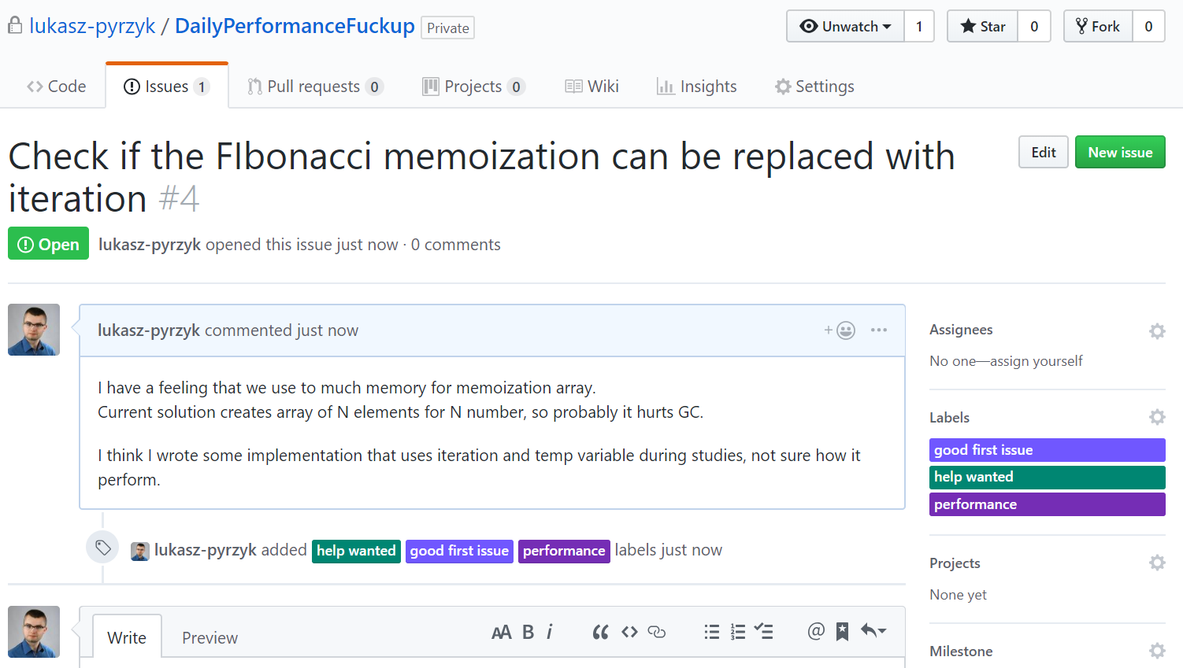
@lukaszpyrzyk

Slide 94
Links
https://github.com/lukasz-pyrzyk/DailyPerformanceFuckup
https://docs.microsoft.com/en-us/azure/cosmos-db/performance-tips
https://docs.microsoft.com/en-us/azure/cosmos-db/sql-api-sql-query-metrics
https://github.com/wg/wrk, https://github.com/giltene/wrk2
http://www.tugberkugurlu.com/archive/efficiently-streaming-large-http-responses-with-httpclient
https://github.com/davidfowl/AspNetCoreDiagnosticScenarios
@lukaszpyrzyk

Slide 95
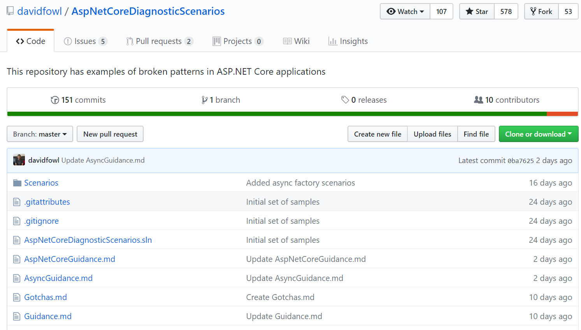
@lukaszpyrzyk

Slide 96
Thank you!
@lukaszpyrzyk
lukasz.pyrzyk@gmail.com

